Slide 1
Timing Diagram of 8085

Slide 2
Timing diagram of 8085
Timing diagram is the display of initiation of read/write and transfer of data operations under the control of 3-status signals IO / M , S1, and S0.
As the heartbeat is required for the survival of the human being, the CLK is required for the proper operation of different sections of the microprocessors. All actions in the microprocessor is controlled by either leading or trailing edge of the clock.
If I ask a man to bring 6-bags of wheat, each weighing 100 kg, he may take 6-times to perform this task in going and bringing it. A stronger man might perform the same task in 3- times only.
Thus, it depends on the strength of the man to finish the job quickly or slowly.
Here, we can assume both weaker and strong men as machine. The weaker man has taken 6-machine cycle (6-times going and coming with one bag each time) to execute the job where as the stronger man has taken only 3-machine cycle for the same job.
Similarly, a machine may execute one instruction in as many as 3-machine cycles while the other machine can take only one machine cycle to execute the same instruction.

Slide 3
Timing diagram of 8085
Thus, the machine that has taken only one machine cycle is efficient than the one taking 3-machine cycle.
Each machine cycle is composed of many clock cycle. Since, the data and instructions, both are stored in the memory, the µP performs fetch operation to read the instruction or data and then execute the instruction.
The µP in doing so may take several cycles to perform fetch and execute operation.
The 3-status signals : IO / M , S1, and S0 are generated at the beginning of each machine cycle.
The unique combination of these 3-status signals identify read or write operation and remain valid for the duration of the cycle.
Table- shows details of the unique combination of these status signals to identify different machine cycles.
Thus, time taken by any µP to execute one instruction is calculated in terms of the clock period.

Slide 4
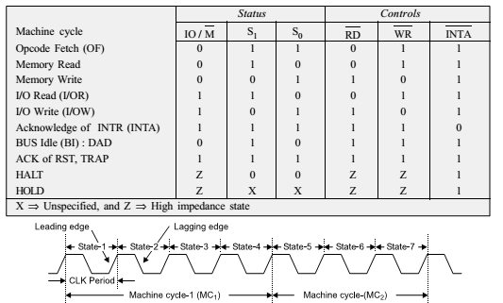
Timing diagram of 8085
Table. Machine cycle status and control signals

Slide 5

PROCESSOR CYCLE
The function of the microprocessor is divided into fetch and execute cycle of any instruction of a program.
The program is nothing but number of instructions stored in the memory in sequence.
Thus, an instruction cycle is defined as the time required to fetch and execute an instruction.
For executing any program, basically 2-steps are followed sequentially with the help of clocks Fetch, and Execute.
The time taken by the µP in performing the fetch and execute operations are called fetch and execute cycle.
Thus, sum of the fetch and execute cycle is called the instruction cycle as indicated in Fig. Instruction Cycle (IC) = Fetch cycle (FC) + Execute Cycle (EC) Fig (a) Processor cycle

Slide 6
Opcode Fetch
The 1st step in communicating between the microprocessor and memory is reading from the memory. This reading process is called opcode fetch.
The process of opcode fetch operation requires minimum 4-clock cycles T1, T2, T3, and T4 and is the 1st machine cycle (M1) of every instruction.
In order to differentiate between the data byte pertaining to an opcode or an address, the machine cycle takes help of the status signal IO/ M , S1, and S0.
The IO/ M = 0 indicates memory operation and S1 = S0 = 1 indicates Opcode fetch operation.
The opcode fetch machine cycle M1 consists of 4-states (T1, T2, T3, and T4).
The 1st 3- states are used for fetching (transferring) the byte from the memory and the 4th-state is used to decode it.

Slide 7
Timing Diagram of Opcode Fetch
The process of opcode fetch operation requires minimum 4-clock cycles T1, T2, T3, and T4 and is the 1st machine cycle (M1) of every instruction.
Example Fetch a byte 41H stored at memory location 2105H.
For fetching a byte, the microprocessor must find out the memory location where it is stored.
Then provide condition (control) for data flow from memory to the microprocessor.
The µP fetches opcode of the instruction from the memory as per the sequence below • A low IO/ M means microprocessor wants to communicate with memory. • The µP sends a high on status signal S1 and S0 indicating fetch operation. • The µP sends 16-bit address. AD bus has address in 1st clock of the 1st machine cycle, T1 . • AD 7 to AD0 address is latched in the external latch when ALE = 1. • AD bus now can carry data.

Slide 8
Timing Diagram of Opcode Fetch
In T 2, the RD control signal becomes low to enable the memory for read operation.
The memory places opcode on the AD bus
The data is placed in the data register (DR) and then it is transferred to IR
During T3 the RD signal becomes high and memory is disabled.
During T4 the opcode is sent for decoding and decoded in T4.
The execution is also completed in T4 if the instruction is single byte.
More machine cycles are essential for 2- or 3-byte instructions. The 1st machine cycle M1 is meant for fetching the opcode. The machine cycles M2 and M3 are required either to read/ write data or address from the memory or I/O devices.

Slide 9
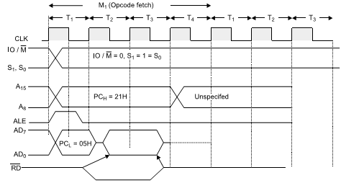
Timing Diagram of Opcode Fetch

Slide 10
Timing Diagram of Opcode Fetch
Example Opcode fetch MOV B,C.
T1 : The 1st clock of 1st machine cycle (M1) makes ALE high indicating address latch enabled which loads low-order address 00H on AD7 ⇔ AD0 and high-order address 10H simultaneously on A15 ⇔ A8. The address 00H is latched in T1. T2 : During T2 clock, the microprocessor issues RD control signal to enable the memory and memory places 41H from 1000H location on the data bus. T3 : During T3, the 41H is placed in the instruction register and RD = 1 (high) disables signal. It means the memory is disabled in T3 clock cycle. The opcode cycle is completed by end of T3 clock cycle. T4 : The opcode is decoded in T4 clock and the action as per 41H is taken accordingly. In other word, the content of C-register is copied in B-register.
Execution time for opcode 41H is Clock frequency of 8085 = 3.125 MHz Time (T) for one clock = 1/3.125 MHz = 325.5 ns = 0.32 µS Execution time for opcode fetch = 4T = 4*0.32 µS = 1.28 µS

Slide 11
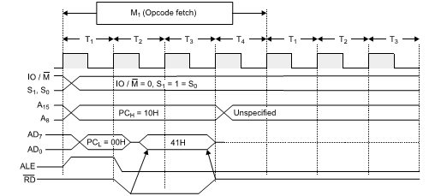
Timing Diagram of Opcode Fetch
Fig. Timing Diagram of Opcode fetch MOV B,C.

Slide 12


Timing Diagram of Opcode Fetch
Explain the execution of MVI B,05H stored at locations indicated below
The MVI B,05H instruction requires 2-machine cycles (M1 and M2).
M1 requires 4-states and M2 requires 3-states, total of 7-states as shown in Fig. 5.3 (d). Status signals IO/ M , S1 and S0 specifies the 1st machine cycle as the op-code fetch.
In T1-state, the high order address {10H} is placed on the bus A15 ⇔ A8 and low-order address {00H} on the bus AD7 ⇔ AD0 and ALE = 1.
In T2 -state, the RD line goes low, and the data 06H from memory location 1000H are placed on the data bus.
The fetch cycle becomes complete in T3-state.
The instruction is decoded in the T4-state. During T4-state, the contents of the bus are unknown.
With the change in the status signal, IO/ M = 0, S1 = 1 and S0 = 0, the 2nd machine cycle is identified as the memory read.
The address is 1001H and the data byte [05H] is fetched via the data bus.
Both M1 and M2 perform memory read operation, but the M1 is called op-code fetch i.e., the 1st machine cycle of each instruction is identified as the opcode fetch cycle. Execution time for MBI B,05H i.e., memory read machine cycle and instruction cycle is Clock frequency of 8085 = 3.125 MHz Time ( T ) for one clock = 1/3.125 MHz = 0.32 µS Time for Memory Read = 3T = 3*0.320 µS = 0.96 µS Total Execution time for Instruction = 7T = 7*0.320 µS = 2.24 µS

Slide 13
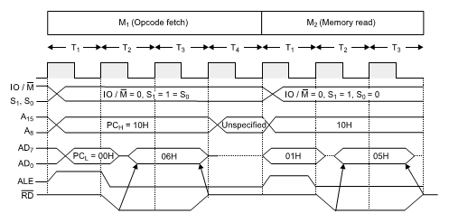
TIMING DIAGRAM OF OPCODE FETCH

Slide 14
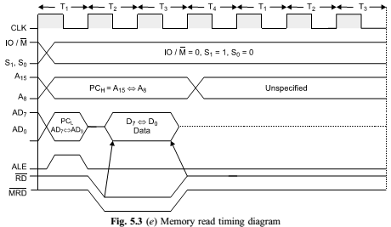
Timing Diagram of Read
Read Cycle The high order address (A15 ⇔ A8) and low order address (AD7 ⇔ AD0) are asserted on 1st low going transition of the clock pulse. The timing diagram for IO/M read are shown in Fig.5.3 (e) and ( f). The A15 ⇔ A8 remains valid in T1, T2, and T3 i.e. duration of the bus cycle, but AD7 ⇔ AD0 remains valid only in T1. Since it has to remain valid for the whole bus cycle, it must be saved for its use in the T2 and T3.
ALE is asserted at the beginning of T1 of each bus cycle and is negated towards the end of T1. ALE is active during T1 only and is used as the clock pulse to latch the address (AD7 ⇔AD0) during T1. The RD is asserted near the beginning of T2. It ends at the end of T3. As soon as the RD becomes active, it forces the memory or I/O port to assert data. RD becomes inactive towards the end of T3, causing the port or memory to terminate the data.

Slide 15
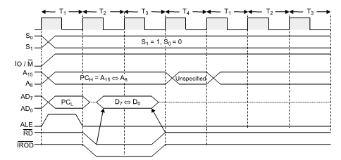
Timing Diagram of I/O Read
Fig: I/O Read timing diagram

Slide 16
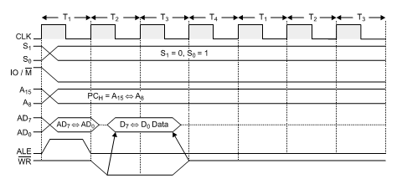
Timing Diagram of Memory Write
Fig: Memory Write timing diagram

Slide 17
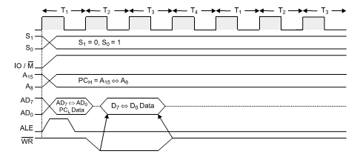
Timing Diagram of IO Write
Fig: IO Write timing diagram

Slide 18
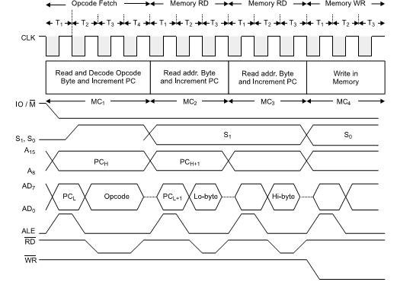
Timing Diagram of STA
Fig: timing diagram of STA

